Slide 1

Marijuana:
MYTHS, MEASURES AND MISUNDERSTANDINGS
Created by:
The Connecticut Association of Prevention Professionals, The Connecticut Chapter of Smart Approaches to Marijuana (SAM)with support and resources from SAM.

Slide 2
Status of Marijuana laws in CT
2011 – Penalties for possession of small amounts of marijuana was reduced to an infraction (decriminalized)
2012 Medical Marijuana passed
2015-2018 Bills to legalize retail sales of marijuana proposed in the legislature each year
2018 – 3 marijuana retail sales bills failed in the Judiciary, General Law and Finance, Revenue and Bonding Committees
2018 – The powerful Appropriations Committee narrowly passed a legalization bill and went to the House calendar, but never getting to the floor for a vote.
2019 – At least Seventeen bills in the legislatures, ranging from DUI studies to medical expansions to employer/landlord protections to retail sales legalization.

Slide 3
Status of Marijuana Bills in the 2019 legislative session
Two retail sales legalization bills have emerged. General Law Judiciary & Finance,. These three bills will likely be merged into one
Public Hearings were held on March 22, 2019 in two of the three committees.
General Law - HB 7371
Judiciary - SB 1085
Both of these committees have voted on and passed these bills by just one vote

Slide 4
Status of Marijuana Bills in the 2020 legislative session
So what’s next in the CT Legislature with Marijuana Bills?

Slide 5


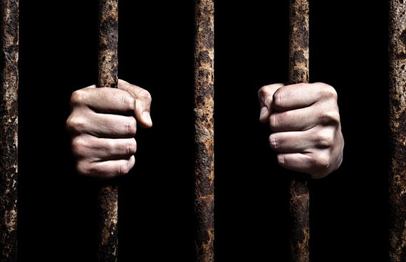

The Myths of Inevitability (based on three assumptions)
MYTH #1: Marijuana is Harmless
MYTH #2: Tax Revenues from Sales Will be a Boon to the State
MYTH #3: It Will Save Money on Law Enforcement and Incarceration

Slide 6
Myth #1: It’s Harmless
Your Father’s Marijuana in 1960s-1980s: 1-4% THC
Today’s Marijuana: Up to 40% THC
Different numbers on this but regularly 4 – 40 X stronger

Slide 7
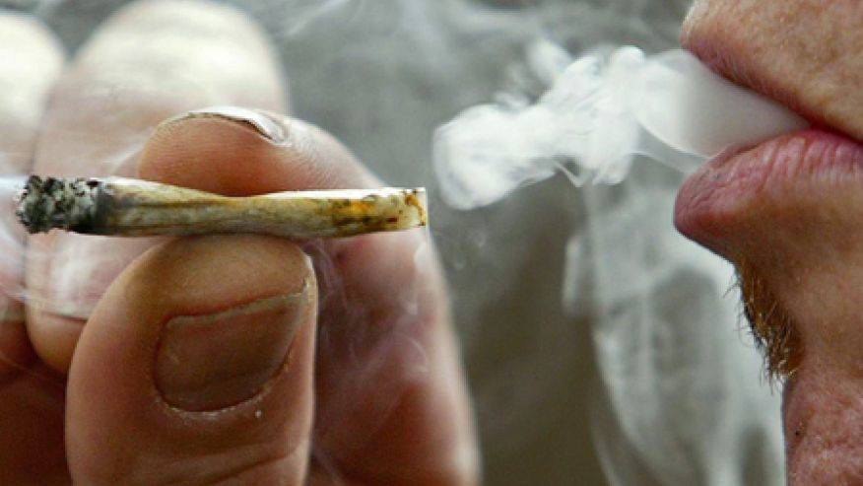
Myth #1: It’s Harmless
HEART: Can cause an increase in risk of heart attack more than fourfold in the hour after use and can provoke chest pain in patients with heart disease.
LUNGS: Marijuana smoke contains 50-70% more carcinogenic hydrocarbons than tobacco smoke, which can be irritants to the lungs and result in greater prevalence of bronchitis, cough and phlegm production.

Slide 8

Myth #1: It’s Harmless
MENTAL HEALTH
Marijuana use is significantly linked with mental illness, especially schizophrenia and psychosis but also depression and anxiety.
.
*Source: Substance Abuse Journal, Mar. 2015: Bagot, Milin, & Kaminer, Neurotoxicol Teratol. 1987;Fried, Makin

Slide 9
Myth #1: It’s Harmless
PREGNANCY:
THC crosses the placenta
THC exposure in utero compromises brain function and IQ in young children (as in adolescents who use to adulthood)
Marijuana smoking during pregnancy has been shown to increase problems with neurological development in newborns especially in motivation, learning, memory, and movement
*Source: Madras, B. Harvard Medical School, 2016
Biological Psychiatry, volume 56, issue12, 15 December 2004, Wang, Edwards, Anderson, Minkjoff, Hurd

Slide 10
True: It’s Addictive!
1 in 6 teens who try marijuana become addicted.
1 in 10 adults who try marijuana will become addicted to it.
Children and teens are six times likelier to be in treatment for marijuana addiction than for all other illegal drugs combined.
Using US census data and CT YRBS data on high school marijuana use rates, CAPP estimates about 10,000 high school students in CT are addicted to marijuana right now.
Source: Anthony, J.C., Warner, L.A., & Kessler, R.C. (1994); Giedd. J.N., 2004 ; CAPP 2016

Slide 11

True: Poor Academic Achievement
Individuals who are daily users of cannabis before age 17 are over 60% less likely to complete high school or obtain a degree compared to those who have never used the drug.
Source: The Lancet Psychiatry, Silins & Mattick Sept. 2014 The study was funded by the Australian Government National Health and Medical Research Council.

Slide 12
True: Poor Academic Achievement + Other Outcomes
From the journal Addiction:
A longitudinal study of 6509 middle school students were surveyed from age 11.5 to 17 years old (high school).
Greater alcohol use predicted greater academic unpreparedness and delinquency.
Greater marijuana use predicted greater academic unpreparedness and delinquency, as well as poorer academic performance and mental health conditions.
Source: Addiction. 2016 Oct;111(10):1825-35

Slide 13
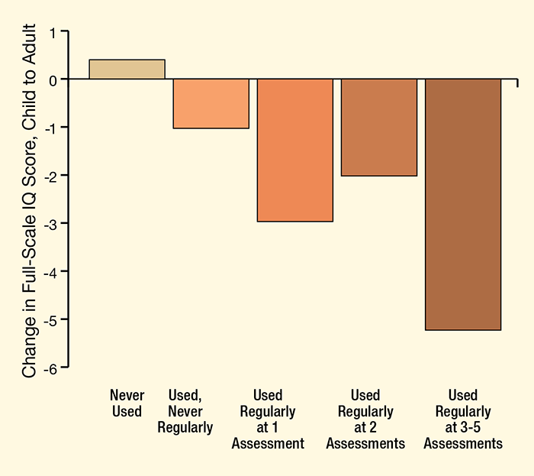
True: It Causes Brain Damage in Adolescents
The hippocampus, which is directly associated with regulating memory and emotions, was found to be 12% smaller in marijuana users as compared to non users.
A 2012 Duke University study demonstrated an average 6-8 point permanent drop in IQ among teens who use marijuana 3-5 times per week.
Source: http://www.drugabuse.gov
Source: Meier, M.H., et al., 2012; MacLeod, J., et al., 2004.

Slide 14
Lessons from Colorado
Youth Marijuana Use:
Youth past month marijuana use increased 20 percent in the two year average (2013/2014) after Colorado legalized recreational marijuana compared to the two-year average prior to legalization (2011/2012).
    Nationally youth past month marijuana use declined 4 percent during the same time.
The latest NSDUH 2015/2016 results show Colorado youth marijuana use is decreasing, but still at least 35% higher than the national average.
In school year 2015/2016, 62 percent of all drug expulsions and suspensions were for marijuana violations.
Sources: NSDUH 2015-2016
Rocky Mountain High Intensity Drug Trafficking Area Report September 2017

Slide 15
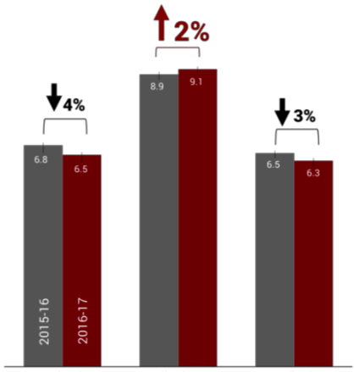
Past Month Use Among 12-17 Year Olds
  National Legalized Non-Legalized
  States States
Source: Nat. Survey on Drug Use and Health, State Estimates 2016-2017

Slide 16
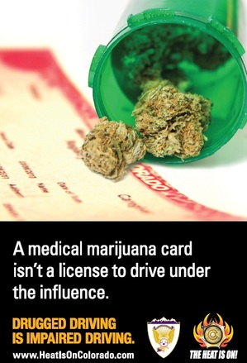
Crashes and Crash Fatalities
The Colorado Department of Transportation found that after passing the “Medical Marijuana” legislation in the state, drivers who tested positive for marijuana in fatal car crashes DOUBLED between 2006 and 2010.
In Washington state, the number of fatally injured drivers testing positive for marijuana more than doubled following marijuana legalization.
Source: National Highway Traffic Safety Administrations
AAA Fondation for Traffic Safety

Slide 17
Lessons from Colorado
Related Data:
Colorado annual tax revenue from the sale of recreational marijuana was about 0.9 percent of total general fund revenue (FY2017).
70% of local jurisdictions in Colorado have banned commercial marijuana businesses.
The amount of alcohol consumed in Colorado increased over 5% between 2013 and 2017.
National THC potency has risen from an average of 3.96 percent in 1995 to an average of 12.55 percent in 2013. The average potency in Colorado was 17.1percent.
More marijuana stores than McDonald’s and Starbucks combined (1,014 retail marijuana outlets, with 394 of them being located with medical marijuana outlets, versus 600 McDonald’s and Starbucks) (RMHIDTA, 2017
Source: Rocky Mountain High Intensity Drug Trafficking Area Report September 2016

Slide 18
Lessons from Colorado
Black Market Activity:
In February 2015, Colorado Attorney General Cynthia Coffman told reporters: “The criminals are still selling on the black market. ... We have plenty of cartel activity in Colorado (and) plenty of illegal activity that has not decreased at all.”
Source: Lessons Learned After Four Years of Marijuana Legalization, SAM, October 2016

Slide 19

The black market is thriving in states that legalize retail sales
This year, more than 78 percent of California’s pot sales are predicted to be illegal
Heavy black market sales continue in all states that legalize, while overall use of marijuana increases.
Source: BDS Analytics, a cannabis market research firm based in Colorado

Slide 20
Lessons from Colorado
Impact on Business:
The CEO of large Colorado construction company GE Johnson has said that “his company has encountered so many job candidates who have failed pre-employment drug tests because of their THC use that it is actively recruiting construction workers from other states.”
The owner of Colorado Springs construction company Avalanche Roofing & Exteriors told The New York Times that in Colorado, “to find a roofer or a painter that can pass a drug test is unheard-of.”
Source: Lessons Learned After Four Years of Marijuana Legalization, SAM, October 2016

Slide 21
Impact on Businesses
The percentage of employees in the combined U.S. workforce testing positive for drugs has steadily risen over the last three years to a reach 10-year high.
Percentage of people who missed work during the past 30 days “because [they] just didn’t want to be there”
  Overall Population = 7.4%
  Alcohol Users = 7.9%
  Marijuana Users = 15%
Source: Quest Diagnostics, 2015; National Survey on Drug Use and Health, 2015

Slide 22
Impact on Businesses
A conservative estimate on costs of legalization to businesses include:
27,153 employees with additional absenteeism problems resulting in additional absenteeism costs of $2,509 per employee per year or over 68 million dollars
Employees that start using marijuana post legalization will be responsible for an additional 2.25 injuries for every 100 full-time workers, resulting in an annual total approximate cost of $20.1 million for CT Employers
Source: The Projected Costs of Marijuana Legalization in Connecticut, 2018, Smart Approaches to Marijuana

Slide 23
Lessons from Colorado
Impact on Communities of Color
Between 2012 and 2014, the number of Hispanic and African American youth under 18 years old arrested for marijuana-related offenses rose 29 percent and 58 percent, respectively. At the same time, the number of white kids arrested for the same crimes fell eight percent.
A 2016 investigation by The Denver Post revealed that a “disproportionate share” of marijuana businesses are now located in lower-income and minority communities in Denver, communities that often suffer disparate impacts of drug use. One of Denver’s lower-income neighborhoods has one marijuana business for every 47 residents.
Source: Lessons Learned After Four Years of Marijuana Legalization, SAM, October 2016

Slide 24
In Colorado, African-Americans continue to be arrested at more than twice the rate of Whites

Slide 25
Myth #1: It’s Harmless
TO RECAP—The science is emerging on the effects of marijuana, but we can say with certainty that marijuana use is significantly linked with:
  Addiction
  Heart and lung complications
  Mental illness
  Car crashes
  IQ loss and poor school outcomes
  Poor quality of life outcomes
  Hiring problems for business
  Increased crime and targeting of minority communities

Slide 26
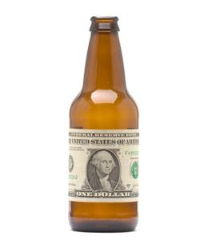
Myth #2: The Revenue Will be a Boon to the State
It Will Bring in Revenue
Just Like:
The Tobacco Tax
The Gambling Money
Alcohol Tax

Slide 27
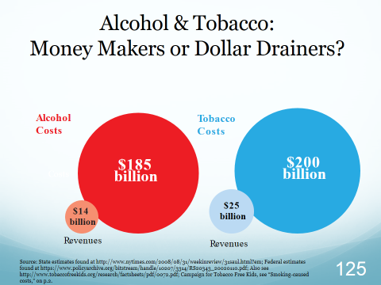
Myth #2: The Revenue Will be a Boon to the State

Slide 28
The Dollars Don’t Make Sense
Projected high estimate for revenue from marijuana legalization in Connecticut (OFA): $113.6 million | Conservatively estimated costs of marijuana legalization in Connecticut: $216 million
Source: The Projected Costs of Marijuana Legalization in Connecticut,
2018. SAM Report

Slide 29
The Dollars Don’t Make Sense
Cost center | Projected annual cost | Percentage of projected revenues (high estimate) | Percentage of projected revenues (low estimate)
Regulatory costs | $15.9 million | 14.0% | 29.2%
Increased drugged driving fatalities | $49.5 million | 43.6% | 91.0%
Increased drugged driving-related non- fatal injuries | $25.4 million | 22.3% | 46.6%
Increased property damage to vehicles related to drugged driving | $26.5 million | 23.3% | 48.7%
Increased ER visits from marijuana intoxication | $4.4 million | 3.8% | 8.0%
Marijuana concentrate extraction lab explosions | $3.6 million | 3.2% | 6.6%
Increased homelessness | $2.7 million | 2.4% | 4.9%
Workplace: Increased absenteeism | $68.1 million | 59.9% | 125.1%
Workplace: Injuries | $20.1 million | 17.7% | 36.9%
TOTAL | $216.0 million | 190.1% | 397.1%
Plus additional, presently unquantifiable costs | Unknown | Unknown | Unknown
Source: The Projected Costs of Marijuana Legalization in Connecticut,
2018. SAM Report

Slide 30
Tax Revenues: Empty Promises
Over half the pot money promised for drug prevention, education & treatment in Washington never materialized…
...Instead, much of it was diverted to the general fund
Source: Initiative 502; Washington State Economic and Revenue Forecast Council (as reported by The Seattle Times)

Slide 31
Marijuana and Insurance
  $200 is the average increase Colorado residents saw in their yearly auto premiums the year after they legalized retail sales of marijuana
  On average, states saw a 10% increase in auto insurance premiums the year they legalized and a 16% increase the following year.
Source: National Association of Insurance Commissioners (2018)

Slide 32
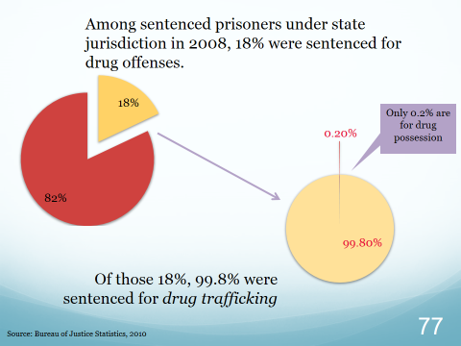
Myth #3: It Will Save Money on Law Enforcement and Incarceration

Slide 33
Myth #3: It Will Save Money on Law Enforcement and Incarceration
In CT, fines have been issued for the past 7-8 years for adult possession of small amounts of marijuana.
According to a 2015 OPM report, there 49 people jailed in CT for possession of controlled substances.
SAM agrees. There is no reason to imprison Marijuana smokers. Treatment and or fines are preferred options.

Slide 34
OPM report on CT Prison Population 2015
Controlling Offense | 2015 Prison Population
Possession of less than 4 ounces of marijuana or controlled substance | 17
Possession of more than 4 ounces of marijuana or hallucinogens | 32
Total 2015 CT Prison Population | 16,095

Slide 35
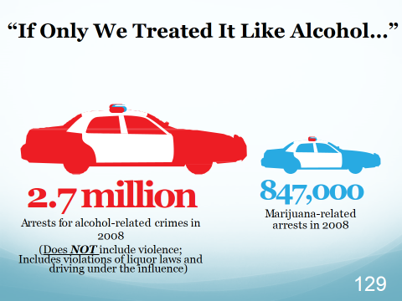
Myth #3: It Will Save Money on Law Enforcement and Incarceration

Slide 36
The Myths of Inevitability
(Based on Three Assumptions)
Marijuana is Harmless
Tax Revenues from Sales Will be a Boon to the State
It Will Save Money on Law Enforcement and Incarceration

Slide 37

Tobacco 2.0: Big Marijuana
“Kids are still more likely to smoke marijuana than adults and even twenty-something’s, presenting a real marketing conundrum for marijuana retailers who seek to increase their business and expand their markets, while also claiming they are only targeting adults”
Steve Pasierb, CEO, Partnership for Drug Free Kids

Slide 38
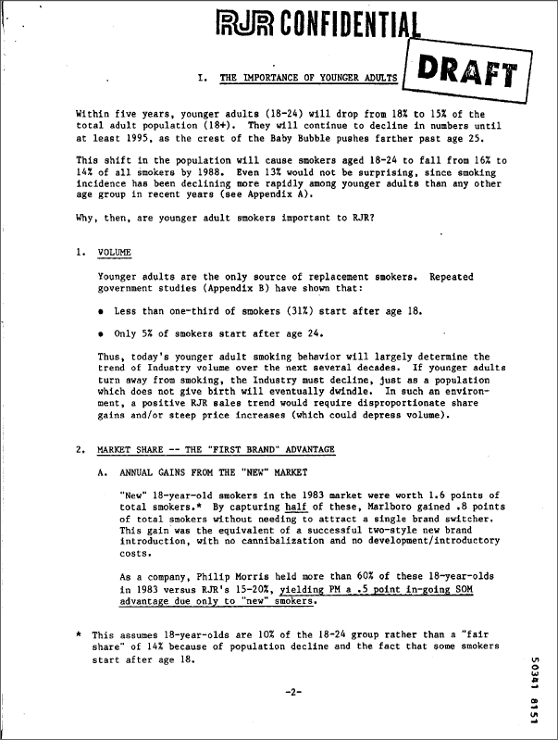
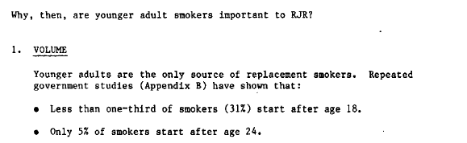

Slide 39

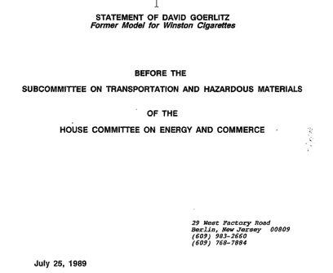
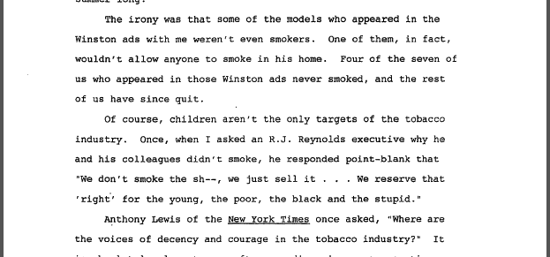
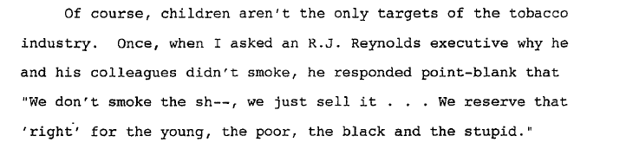

Slide 40

Alcohol Industry “Self-Regulation”
Distilled Spirits Council of the United States(DISCUS) Code:
Beverage alcohol advertising and marketing materials should not contain any lewd or indecent images or language

Slide 41
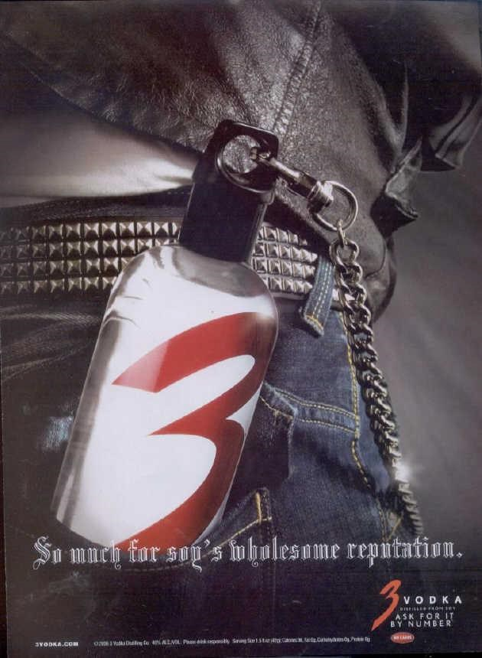
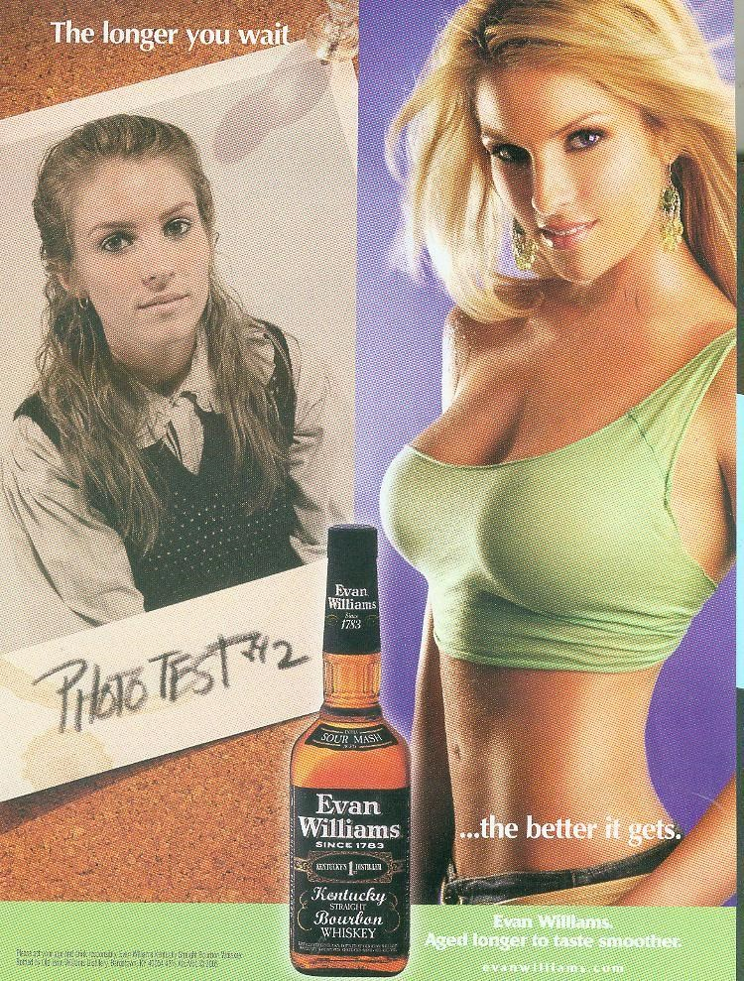
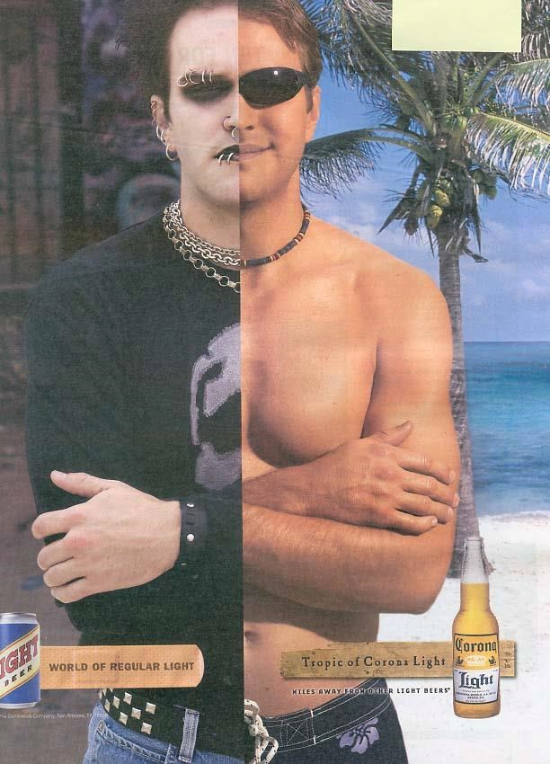
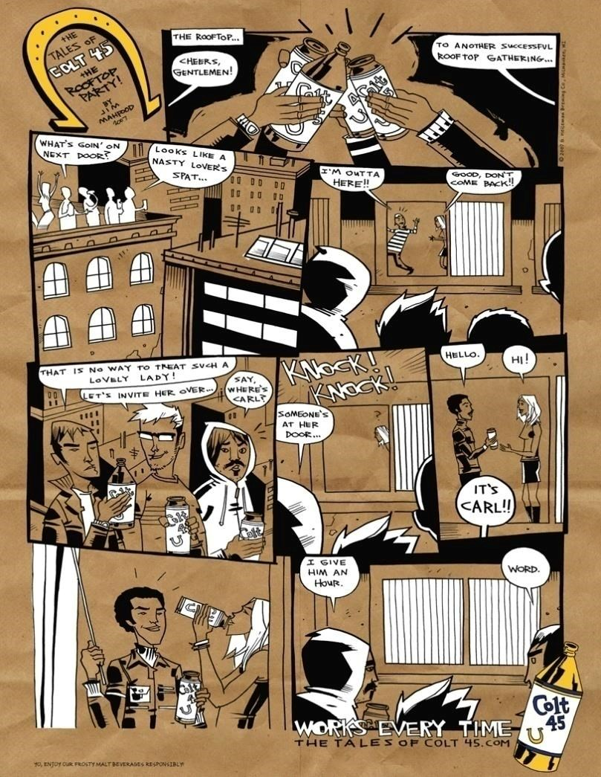
Youth Exposure to Alcohol Advertising: Magazines
-
In 2008, kids aged 12-21 per capita saw
(compared to adults 21 and over):
10% more beer ads
16% more ads for alcopops
73% fewer wine ads
The overwhelming majority of youth exposure (78%) came from ads placed in magazines with disproportionate youth audiences. The same examples are found in radio ads and social media.
Source: Center for Alcohol marketing and Youth, CAMY.org

Slide 42
Powerful Pot Lobby Pushes Back Against Regulation Attempts
Colorado’s pot lobby has been hard at work stacking the deck since legalization passed in 2012, including:
Blocking legislation to deter use of illegal pesticides that promote marijuana production
Suing over restrictions on marijuana advertising targeting children
Proposing legislation to move regulatory authority from existing state department’s to a special committee packed with industry representatives
Making it more difficult for local initiatives restricting marijuana businesses to be represented on the ballot by raising the threshold for signature collection, from 5% to 15% of the voting electorate
Sponsoring an initiative in Denver to allow pot smoking in restaurants and cafés
Source: Lessons Learned After 4 Years of Marijuana Legalization: SAM, October 2016

Slide 43
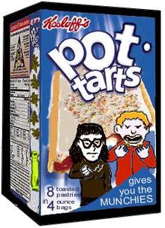
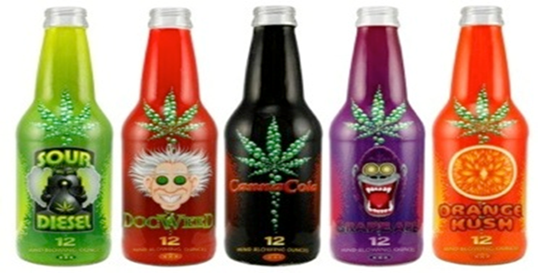
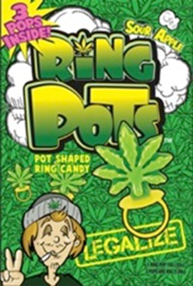
Edibles
A variety of marijuana products and ‘edibles’ can be found at marijuana stores and dispensaries:
Brownies, carrot cake, cookies, peanut butter, granola bars, ice cream, gummies and other candies. Many such as ‘Ring Pots’ and ‘Pot Tarts’ are marketed with cartoons and characters appealing to children

Slide 44
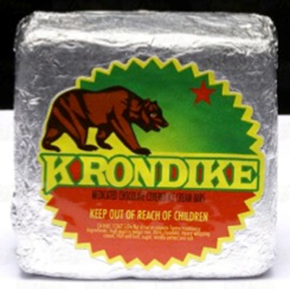
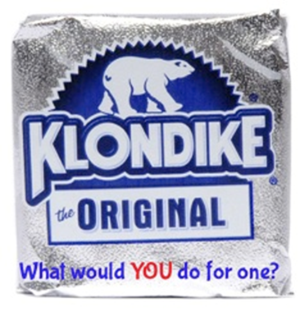

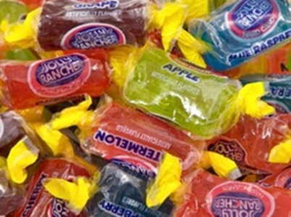
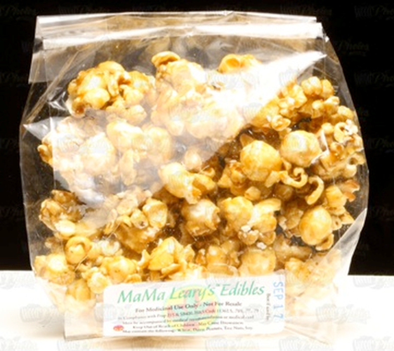
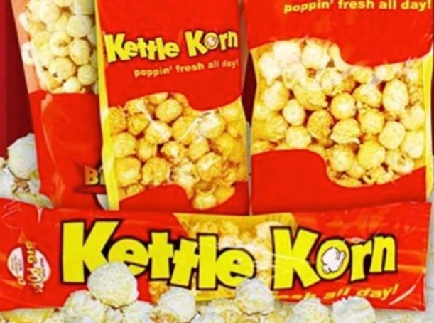

Slide 45
In Conclusion
Marijuana is harmful (all drugs are).
Revenues will be eclipsed by new costs. The only money to be made is by marijuana entrepreneurs.
We don’t save money on legal alcohol, so why would we save money on legal marijuana? State coffers will suffer, taxes could increase.
Corporations will act on behalf of their stock holders to maximize profits. Efforts to put controls on tobacco, alcohol, etc. have not worked.

Slide 46

www.cappct.org
John Daviau, MACP, CPS
Executive Director
john@cappct.org

